Slide 1

Virtual Reality
TCS 675
Ms. Neha Sharma
Assistant Professor
Graphic Era Hill University, Haldwani
SOC Department

Slide 2
Course Outcomes
CO1: Demonstrate an understanding of techniques, processes,
technologies and equipment used in virtual reality
CO2: Identify appropriate design methodologies for immersive
technology development, especially from a physiological
perspective
CO3: Exploit the characteristics of human visual perception in
Virtual Reality techniques
CO4: Create effective VR techniques for the Web
CO5: Effectively categorize the benefits/shortcomings of
available VR technology platforms.
CO6: Use human factors to design and evaluate a VR application

Slide 3
Syllabus
UNIT 2
Degrees of Freedom: VR input devices Relative and Absolute Degrees of Freedom, Six DOF
Selection and Manipulation in VR: Isomorphic and Non- Isomorphic, Egocentric and Exocentric Interaction techniques, Selection with HMDs

Slide 4
Degrees of Freedom
"degrees of freedom" (DoF) refers to the number of independent ways a user can move within a virtual environment, with "relative" DoF meaning movement is tracked relative to the user's current position, while "absolute" DoF tracks the user's exact position in space, allowing for full movement throughout the virtual environment.
Degrees of freedom (DoF) refer to the number of basic ways a rigid object can move through 3D space. There are six total degrees of freedom. Three correspond to rotational movement around the x, y, and z axes, commonly termed pitch, yaw, and roll. The other three correspond to translational movement along those axes, which can be thought of as moving forward or backward, moving left or right, and moving up or down.

Slide 5
VR headsets and input devices are generally 3DoF or 6DoF.
3DoF means we can track rotational motion but not translational. For the headset, that means we can track whether the user has turned their head left or right, tilted it up or down, or pivoted left and right.
6DoF means we can additionally track translational motion. That means we can track whether the user has moved forward, backward, laterally, or vertically.

Slide 6
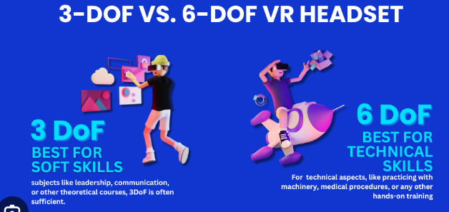

Slide 7
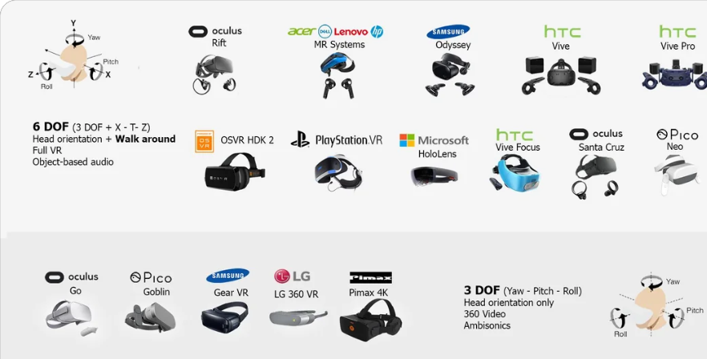

Slide 8
Key development differences
3DoF head-tracking means you can only track rotational movement.
6DoF head-tracking means you can track both position and rotation.
In 3DoF you need to use a neck model to simulate realistic movement, which Daydream provides.
In 6DoF a neck model is not necessary because the actual position and rotation of the head are known.

Slide 9
How is 3-DoF tracking achieved?
3-DoF headsets provide the simplest form of user tracking in VR. It relies mostly on inbuilt sensors (accelerometers, gyroscopes and magnetometers) that devices (such as a smartphone) use to measure movement.
Examples of 3-DoF VR headsets:
Google Cardboard
Oculus Go
Merge VR
Samsung Gear VR
Google Daydream

Slide 10
Accelerometers, gyroscopes, and magnetometers are all sensors used to detect motion, with each specializing in a different aspect: an accelerometer measures linear acceleration, a gyroscope measures rotational velocity (angular rate), and a magnetometer detects the Earth's magnetic field to determine orientation based on compass direction; when combined, they provide a comprehensive understanding of an object's movement in 3D space, often used in applications like smartphones, drones, and navigation systems.

Slide 11
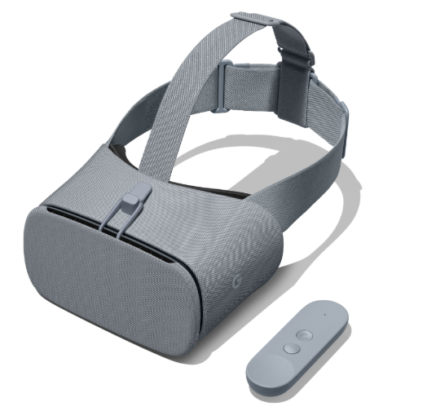
The Daydream View is a comfortable, lightweight, and easy-to-wear headset featuring an NFC sensor that allows the phone to automatically detects it is placed into the headset. The Daydream View also comes with a Daydream controller, which combines a simple, intuitive user inferface with 3DoF functionality. All Daydream apps must work with the Daydream controller.

Slide 12
6-DoF headsets
6-DoF headsets allow us to track translational motion as well as rotational motion. We can determine whether a user has rotated their head and moved:
Forward or backward
Laterally or vertically
Up or down
This type of tracking is important for VR experiences with translational motion and gives the user a lot more freedom to explore locations, inspect details and perform real life tasks in VR.
Examples of 6-DoF VR headsets:
Oculus Rift
Oculus Quest
Pico Neo
HTC Vive
Windows Mixed Reality
Apple Vision Pro

Slide 13
How is 6-DoF tracking achieved?
Early versions of 6-DoF headsets typically use positional tracking sensors (usually two physical devices positioned around the room which can track headset movement) – for example the Oculus Rift is embedded with infrared LEDs which are monitored by two 30cm tall sensor towers positioned approximately 1.5m apart.
Modern VR headsets may use inside-out tracking to achieve 6-DoF. From the Microsoft Mixed Reality documentation: “the tracking system uses two visible-light low-resolution cameras to observe features in your environment, and fuses this information with IMU data to determine a precise position of the device in your environment.”

Slide 14
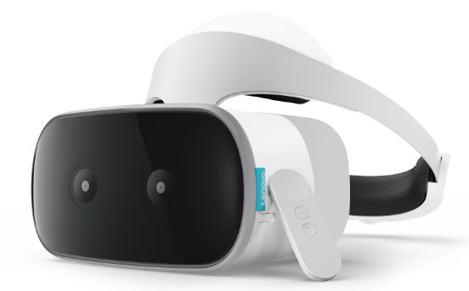
Daydream Standalone headsets feature WorldSense, which provides 6DoF tracking (sometimes referred to as "inside-out tracking"), without the need for cables, phone or a PC. Daydream Standalone headsets deliver an immersive, portable VR experience without the complicated setup.
Key features:
Increased processor and cooling performance, which means more powerful apps without thermal or other performance issues.
WorldSense provides reliable 6DoF inside-out tracking at sub-cm accuracy.
High quality, VR-optimized displays featuring greater resolution and higher FoV.
Field-of-View (FOV) adjusts the amount of the scene that is visible in a viewport and the amount of perspective flare.

Slide 15
Here are some examples to highlight applications across the two:
3-DoF:
Watching 360 degree videos or images
Viewing the interior of a house in VR before purchasing
Practicing delivering a speech at a conference
6-DoF:
Car mechanic inspecting the engine of a vehicle
Cooking simulator training the user how to make a meal
Action games where the user needs to avoid objects (e.g. bullets)

Slide 16
Selection and Manipulation in VR
"selection and manipulation" refers to the process of choosing a virtual object and then interacting with it by moving, rotating, or scaling it
"Selecting a virtual object in 3D space" refers to the process of choosing a specific computer-generated object within a three-dimensional virtual environment, typically done by aiming a virtual pointer or "ray" at the object using a controller or other input device, allowing the user to interact with it
this is a fundamental interaction technique in virtual reality (VR) applications, where users can manipulate objects by selecting them in the 3D space around them

Slide 17
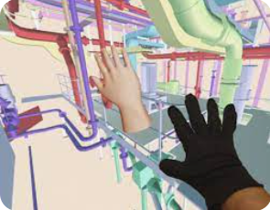
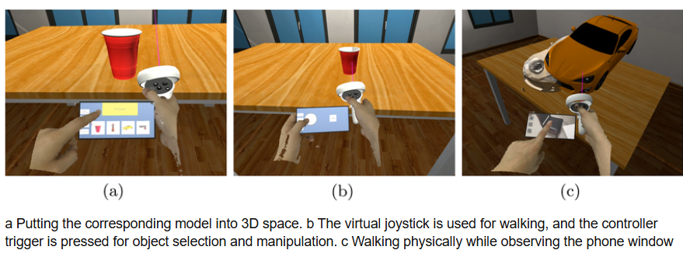
Selection and Manipulation in VR

Slide 18
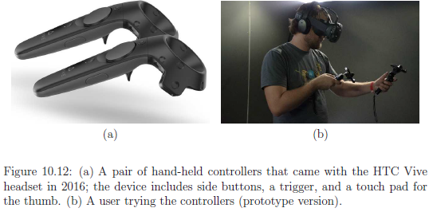
Selection and Manipulation in VR

Slide 19
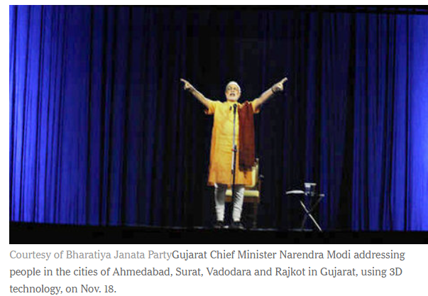
From avatars to visual capture How should others see you in VR?
Social Interaction
connecting humans together is one of the greatest potentials for VR technology. Although it might seem isolating to put displays between ourselves and the world around us, we can also be brought closer together through successful interaction mechanisms.

Slide 20
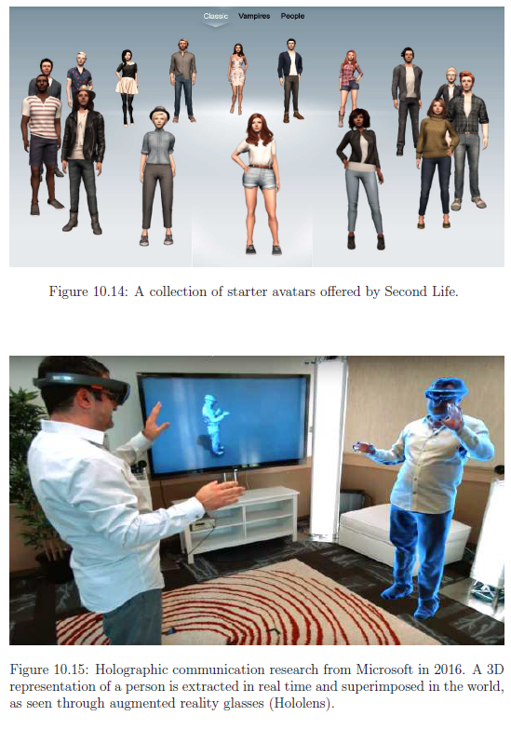
From avatars to visual capture How should others see you in VR?
Social Interaction:
At one extreme, a user may represent himself through an avatar, which is a 3D representation that might not correspond at all to his visible, audible, and behavioral characteristics
At the other extreme, a user might be captured using imaging technology and reproduced in the virtual world with a highly accurate 3D representation

Slide 21
Key points about virtual object selection in 3D space:
Interaction methods:
Common methods include using a controller-based ray-casting (pointing at an object with a virtual "beam"), hand gestures, eye-gaze tracking, or a combination of these depending on the VR system.
Selection tools:
To determine which object is selected, a "selection volume" is often used, which can be shaped like a cone, sphere, or cube, and the object that intersects this volume is chosen.

Slide 22
Challenges in 3D selection:
Occlusion: When objects overlap, identifying the desired object can be difficult.
Distance and precision: Selecting small or far-away objects might require more precise control.
Cluttered environments: In complex scenes with many objects, choosing the correct one can be challenging.
Examples of applications using 3D object selection:
VR gaming: Picking up items in a game world
Virtual design tools: Selecting components in a 3D model to manipulate them
Medical training simulations: Interacting with virtual anatomical structures
Industrial design: Manipulating virtual prototypes

Slide 23
“Isomorphic" and “Non-Isomorphic” Selection
It describe the relationship between the user's physical movement and the virtual object's movement
"isomorphic" refers to a direct, one-to-one mapping between a user's physical movement and the corresponding action of a virtual object, essentially mirroring real-world interaction
Isomorphic:
Example: If you move your hand forward to grab a virtual object and it moves forward in the VR environment at the same rate and direction, that's an isomorphic interaction.
Benefits: Feels natural and intuitive, promotes immersion in the virtual environment.
Drawbacks: Can limit creative manipulation options, may not be ideal for complex tasks.

Slide 24
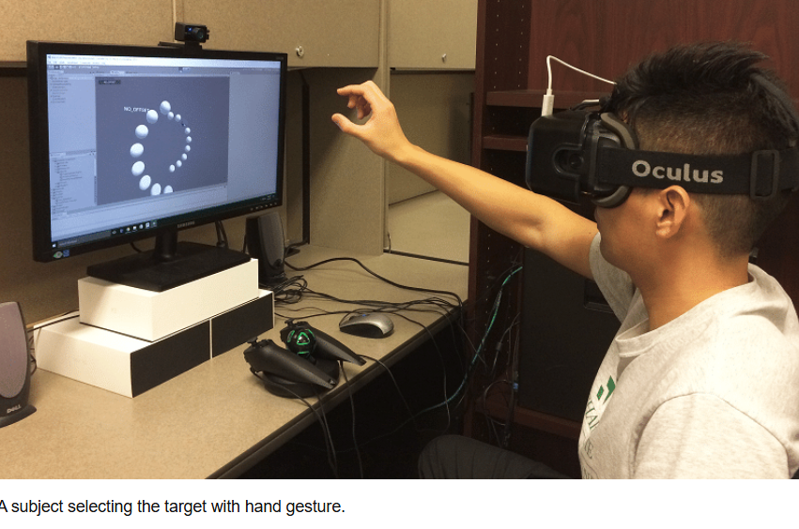
Isomorphic Selection

Slide 25
"non-isomorphic" describes a mapping where the user's actions are translated to virtual object manipulation in a non-linear or less intuitive way, allowing for more complex or "magic-like" interactions that may not directly reflect physical movements.
Example: A user might make a small hand gesture to rotate a large virtual object by a significant amount, or use a hand gesture to scale an object without physically mimicking the scaling motion.
Pros: Enables powerful manipulation capabilities, allows for more creative interactions, can be useful for complex tasks where direct mapping is not ideal.
Cons: Can be less intuitive, require users to learn specific interaction patterns, potentially breaking immersion if not designed well.

Slide 26
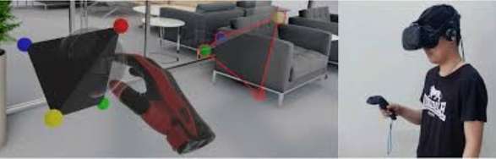
Non-isomorphic Selection

Slide 27
Interaction techniques
Based on the current technology, three major kinds of similarity can be independently considered:
1. Visual appearance: How close does the avatar seem to the actual person in terms of visible characteristics?
2. Auditory appearance: How much does the sound coming from the avatar match the voice, language, and speech patterns of the person?
3. Behavioral appearance: How closely do the avatar’s motions match the body language, gait, facial expressions, and other motions of the person?

Slide 28
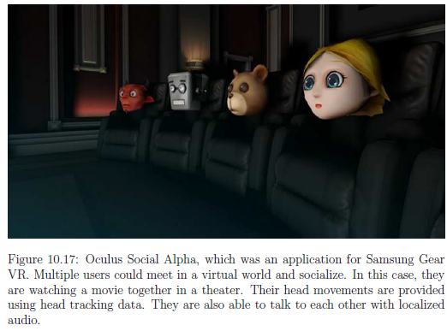
Interaction techniques

Slide 29
“Egocentric" and “Exocentric“
Interaction techniques
It defines the perspective from which the user interacts with the virtual environment
Egocentric Interaction :
The user's perspective is directly tied to their virtual viewpoint, meaning they interact with objects as if they are seeing them from their own eyes in the virtual environment.
Example: Pointing at a virtual object with a hand controller directly in front of you in the VR space.

Slide 30
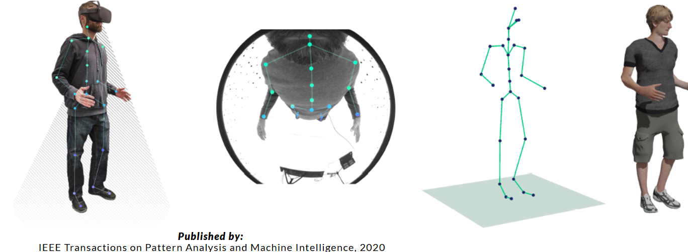
Egocentric Interaction

Slide 31
Exocentric Interaction
The user has a more detached perspective, often using a virtual cursor or manipulator to select and interact with objects in the virtual world, similar to a traditional computer mouse.
Example: Using a virtual hand cursor to select an object that is far away from the user, allowing for precise targeting.

Slide 32
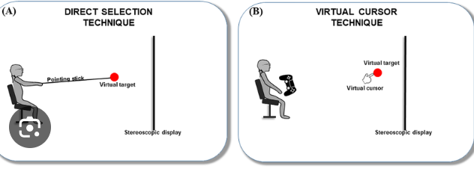
Exocentric Interaction

Slide 33
Selection with HMDs
Head-mounted displays (HMDs) are small displays or projection technology integrated into eyeglasses or mounted on a helmet or hat.
Raycasting
Gaze-Based Selection
Direct Manipulation

Slide 34
Raycasting
A common selection technique where a virtual "ray" is projected from the HMD's center point to the virtual environment, allowing the user to select objects by looking at them and pressing a button on the controller.
How it works
The user points a ray of light at a target
The user confirms the selection with a voice command, button click, or motion gesture
Challenges
Raycasting can result in selection ambiguity when a ray intersects multiple targets at different depths
Previous adaptations of raycasting can take time for users to learn

Slide 35
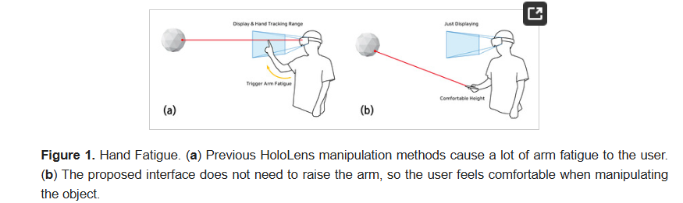
Raycasting

Slide 36
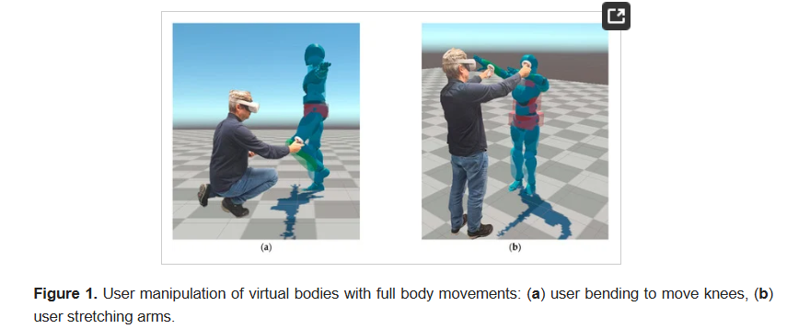
Direct Manipulation
Selecting objects by physically reaching out to them with a virtual hand, often used in conjunction with hand tracking technology.
The avatar implements inverse kinematics provided by Unity (https://docs.unity3d.com/2021.3/Documentation/Manual/InverseKinematics.html, accessed on 11 November 2023).

Slide 37
Gaze-Based Selection
Selecting objects by simply looking at them for a predetermined duration, sometimes combined with additional input to confirm selection
Gaze-based selection is a method of selecting something using eye movements. A gaze tracker records eye movements and a computer program translates them into screen coordinates.
How it works
A gaze tracker uses an inbuilt light sensor to monitor pupil reflections
The tracker estimates the position of the eye using the pupil or iris center
The tracker converts eye movements into mouse movements or commands
The user controls the cursor by looking around on the screen
Blinking performs a click

Slide 38
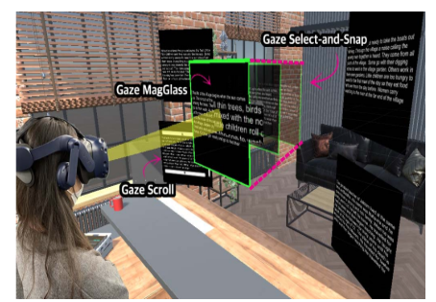
Gaze Select-and-Snap for document selection, Gaze MagGlass for enhanced text legibility, and Gaze Scroll for ease of document traversal.

Slide 39
A "virtual reality selection and manipulation method" refers to the technique used in a VR environment to choose (select) and interact with virtual objects, typically done through hand controllers, gaze interaction, or gestures, with the most common method being "ray-casting" where a virtual laser pointer is projected from the controller to select an object within the virtual space.

Slide 40
Panoramic productivity with
Mac Virtual Display
Using Mac Virtual Display is like having an expandable, ultrawide screen that wraps around you. It’s the equivalent of having two 5K monitors side by side, creating one massive, curved display. Now you can choose Standard, Wide, or Ultrawide and enjoy rich stereo sound from your Mac apps.

Slide 41
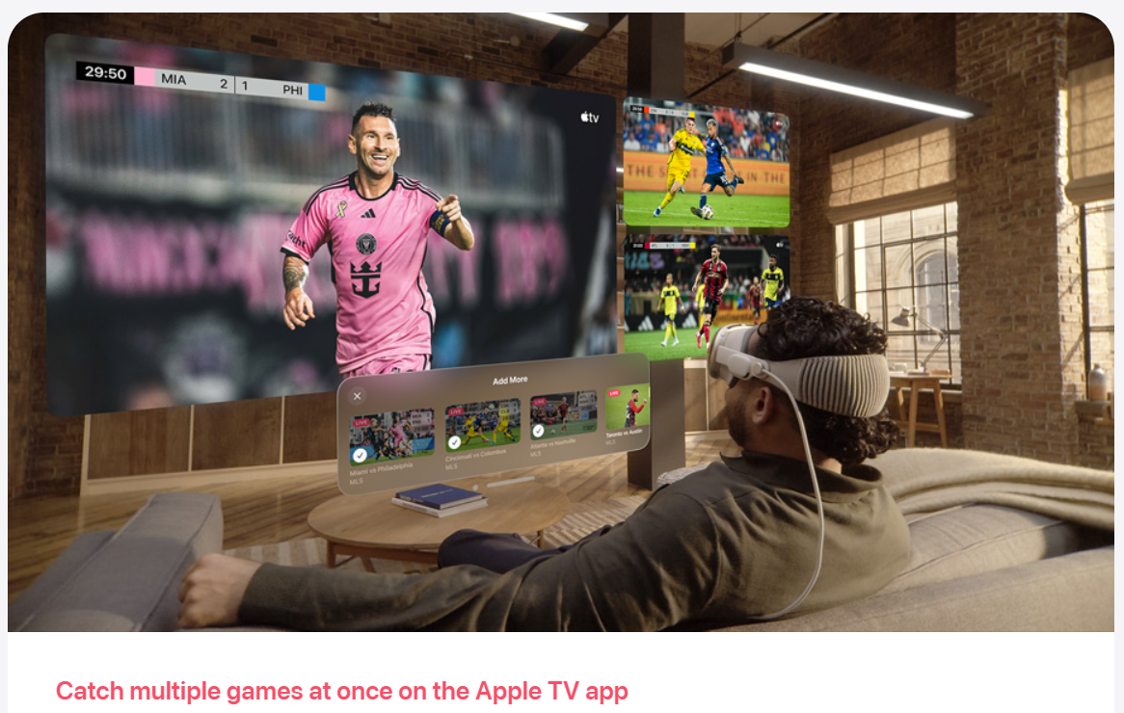

Slide 42
What are Head-mounted Displays?
head-mounted displays, or HMDs are probably the most instantly recognizable objects associated with virtual reality. As such, they are also referred to sometimes as ‘Virtual Reality headsets’, or ‘VR glasses’. HMDs attach straight to your head and present visuals directly to your eyes, and perhaps most excitingly, to your peripheral vision as well.
HMDs are not only used in virtual reality gaming, they’ve also been utilized in military, medical and engineering contexts to name a few. As seen in educational films such as The Terminator, these devices can be used to create something called augmented reality, which overlays digital information through an HMD filter onto the real world.

Slide 43
for the best possible experience with an HMD, a number of technologies need to be incorporated.
Display Technology: Today, an HMD might use one of several techniques to transfer images to brain, but the most common is the use of liquid crystals. This is more commonly known as an LCD panel, the same type of panel used in smartphones, modern televisions and computer monitors.
Pixels and displays: Pixels (short for pixel elements) are the dots that make up a picture. The more pixels you have in every square inch of display, the crisper the image.
Retinal projection: Retinal Projection is a technology that hasn’t seen much widespread use yet, but does exist in some headsets
This technology uses a combination of tiny digital projectors and microscopic mirrors to project images onto your retina

Slide 44
Refresh rate: The refresh rate refers to how quickly a display can change its content over a particular length of time. Typically, modern LCD computer monitors can do this 60 times per second, or at 60Hz. This also corresponds to a maximum frame rate of 60 frames per second – or 60fps – where one frame equals a complete image on your screen.
Latency is the term used for the time between input and output. For the layman, that means the time it takes for the picture in your VR world to catch up to your new head position each time. In order for VR technology to fool your brain into thinking that you are in an immersive world, the technology requires very low latencies. An absolutely top-notch experience usually equals latency of 20ms or less; any more and we start to notice an unnatural lag.

Slide 45
Optics: If you were to take your smartphone’s LCD screen and hold it right up to your face, it still wouldn’t fill your entire field of vision in the way a VR headset aims to. In order to create that immersive feeling of inhabiting a virtual world, you have to stretch that flat image to fill your visual field entirely. This is commonly referred to as optics.
Head Tracking: To acknowledge your head’s position and transform that into other data, your HMD needs some accurate head tracking technology. we can now put a multi-axis accelerometer (which sounds entirely made up, but it is not) on a chip, allowing infrared tracking cameras to accurately watch markers on the HMD and relay positional data to the computer
Eye Tracking: It tracks where your eyes are currently looking and can extrapolate that information to change it into visual data. With this technology, your HMD could potentially change the depth of field of the visuals on-screen to simulate natural vision much more closely.

Slide 46
Audio Hardware: Some HMDs currently include their own optional headphones, while others do not. Positional, multi-speaker audio that gives you the illusion of a 3-dimensional world is a technology that already very much exists (for example you may already use surround sound somewhere in your home), and it can slot in seamlessly with existing HMDs.
Computer Hardware: The first operates on a totally self-contained basis. It possesses all the necessary computer hardware required to function as a VR headset, allowing it to collect and display the input it receives from you.
The second type of HMD does not have any computing power. This means it must interface with an external computer. Usually these HMDs accept High-Definition Multimedia Interface (HDMI) input and use a Universal Serial Bus (USB) connector to send head tracking data through.
The third class of device is one that does a bit of both, having its own onboard hardware, but also allowing input from external devices.

Slide 47
Why doesn’t all VR use 6DoF?
this is because of cost. The hardware and software to have 6 DoF tracking is far more complex than 3 DoF tracking. Most mobile VR headsets use the built it inertial measurement unit (IMU) sensor to read is orientation. This is the same sensor that turns your screen landscape when watching a video on your mobile. Whereas, 6 DoF systems need infrared or optical tracking systems to track specific points on their headset or controllers in 3D space. The extra hardware increases price but with greater functionality.
So, which is better?
For an immersive experience which you can move in a room and pick ups up off the floor, 6 DoF is the way forward. However, if you want to watch films or ride a vehicle for example, 3 DoF can be just as immersive.

